Slide 1
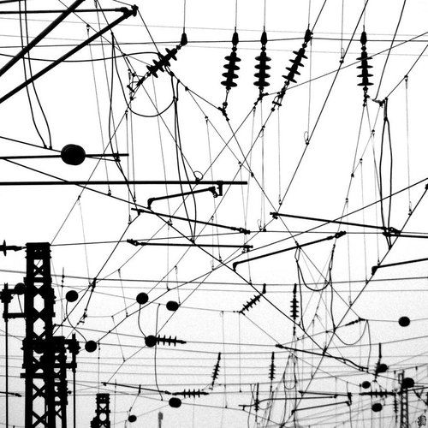
IoT Link Layer Protocols
Frank Walsh

Slide 2
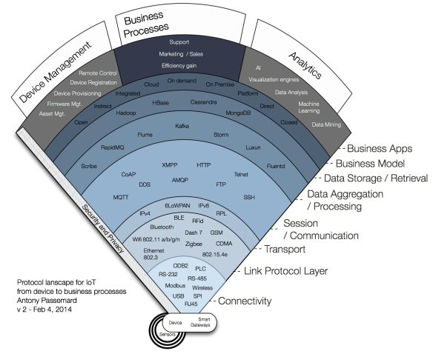
Link Protocols
Focusing down here.
Summerise IoT applicable protocols.

Slide 3
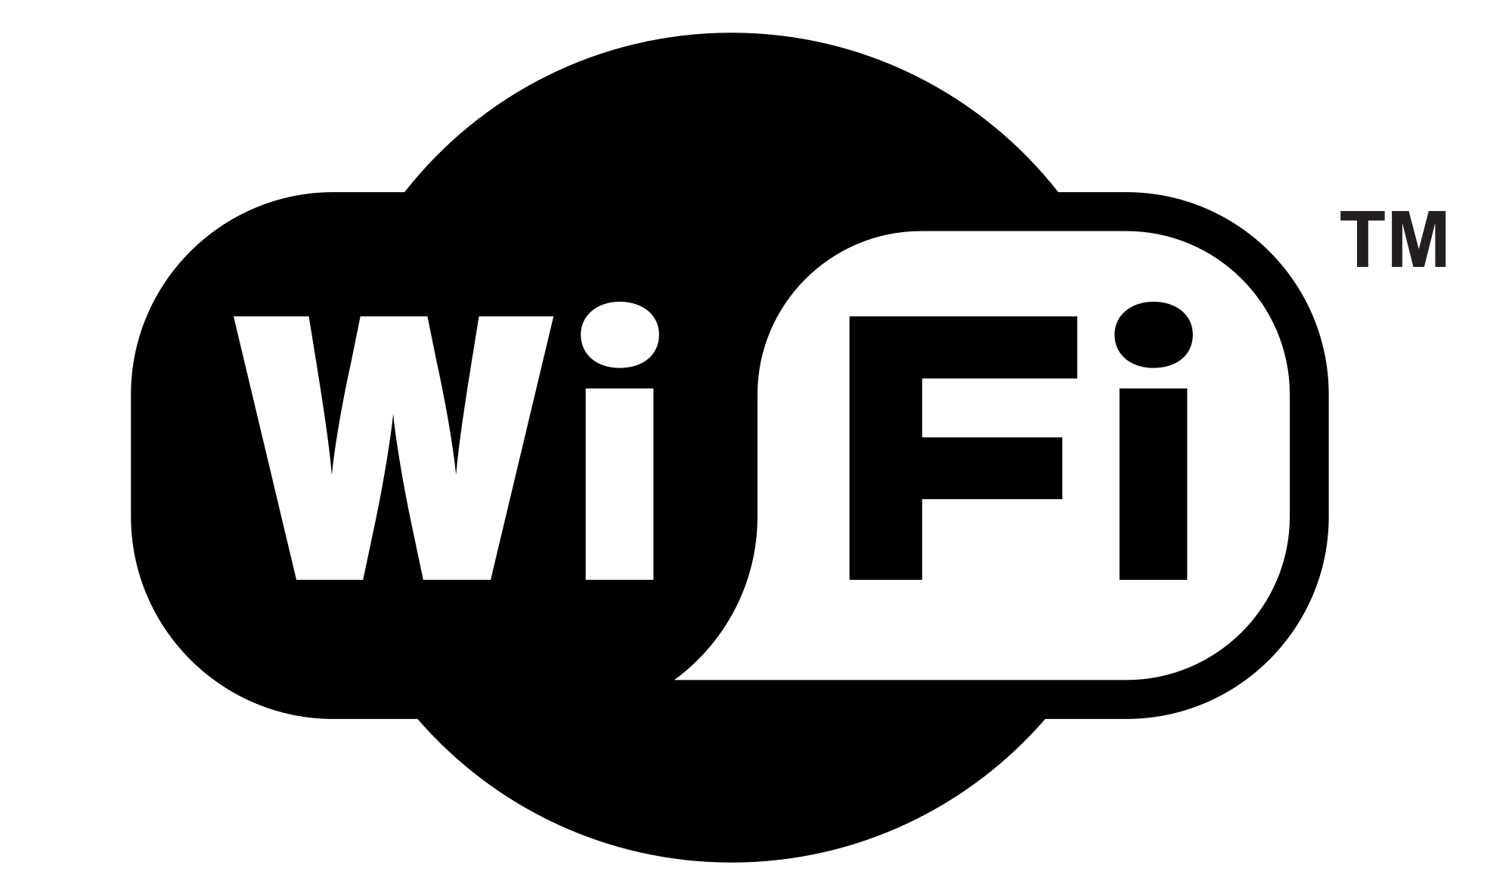
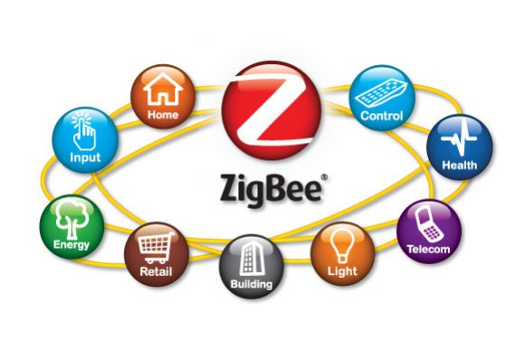



Protocols of note for IoT at link Layer

Slide 4
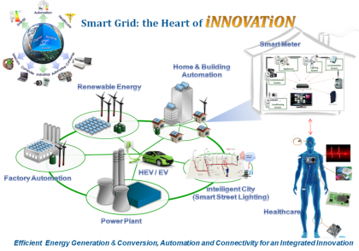
Power Line Communication (PLC)
Origins in 1950s
remote lighting of street lights. 100 Hz and 1 kHz signals over electrical wires.
Uses existing electrical wiring to carry both data and electric power
Applicable to
Internet access
Utility management
Home automation
IoT

Slide 5
Evolution

Slide 6
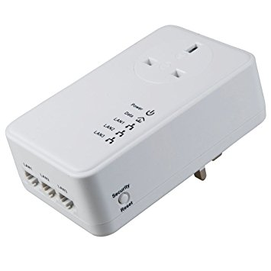
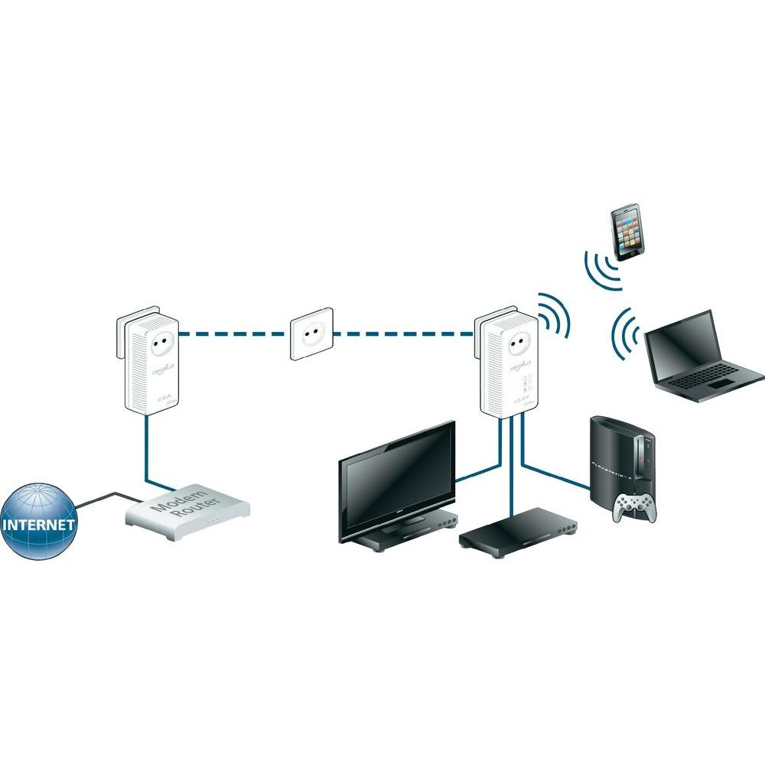
HomePlug
HomePlug 1.0
provides a peak PHY-rate of 14 Mbit/s. Replaced by HomePlug AV
HomePlug AV/AV2
AV has sufficient bandwidth for applications such as HDTV and VoIP. Peak data rate of 200 Mbit/s at the physical layer. AV2 achieves gigabit-class PHY-rate
HomePlug GP
HomePlug Green PHY specification is a subset of HomePlug AV. Intended for smart grid. Peak data rates of 10 Mbit/s
Designed for home appliances and plug-in electric vehicles

Slide 7
HomePlug
1.8 – 30 MHz spectrum.
Uses Orthogonal Frequency Division Multiplexing (OFDM)
Robust:
Same information transmitted on 2-5 subcarriers
Uses low-bit rate modulation (more resilient to High Freq. noise)
Devices form an AV logic Network (AVLN)
Share a 128 bit AES key
Each AVLN has central coordinator
Transmission over 2 lines (live and neutral)

Slide 8
Security
AVLN Netork Membership Key
All devices have default NMK
Users/developers can configure devices to specific NMK
Using NMK, device can request an encryption key

Slide 9
HomePlug AV2
Compatible with AV and GP
In addition
Additional spectrum
MIMO(Multiple Input Multiple Output): two wires with three wire combinations(line-neutral, line-ground, neutral-ground)
Lower overhead: shorter packet
Repeating: intermediate devices can demodulate-remodulate
Better encoding
Power efficient: Stations can declare sleep periods

Slide 10
HomePlug GreenPHY
Deigned for home area networks
Monitoring and control apps
Hence lower power, lower data rates, lower cost
Embedded in Smart Home devices:
smart appliances
programmable communicating thermostats (PCTs)
electric meters
plug-in electric vehicles (PEVs)
Audi, BMW, Daimler, Ford Motor Company, General Motors, Porsche and Volkswagen use HomePlug Green PHY specification for PEVs.
a common, recognized standard to reduce the build complexity for suppliers and infrastructure providers.

Slide 11
HomePlug GreenPHY
Complies with IEEE 1901-2010 (powerline networks)
Compatible with AV and AV2
Up to 10Mbps
Uses 75% less power than HomePlug AV
Version 1.1 has specific features for Evs
Secure billing at public chargers

Slide 12
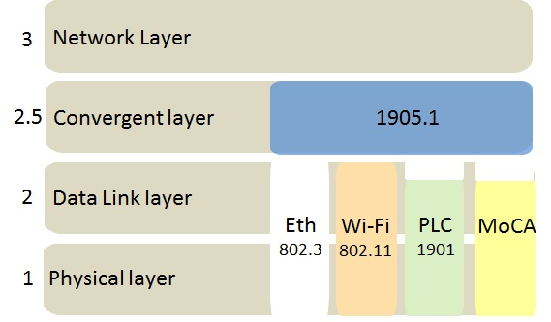
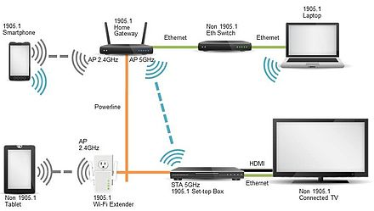
Convergent Digital Home - IEEE 1905
defines a network enabler for home networking
Combines WiFi, HomePlug, Ethernet, Multimedia over coax(MoCA) at home
Makes home look like single network
Devices can aggregate data through multiple interfaces
Also allows fallback on link failure
Convergent layer used to exchange Control Message Data Units(CMDU)
No changes to underlying tech.

Slide 13
IEEE 1905.1 Management
Compliant devices use Abstraction Layer Management Entity (ALME) (protocol)
Neighbour discovery
Topology exchange/change notifications
Flow forwarding rules
Security associations
Common Topology
Homeplug as backbone for WiFi

Slide 14
IEEE 1905.1 Security
Push button
Press button on new and existing device
Passphrase/key in new device
NFC: User touches new device with NFC device which is existing member
Auto Config:
New access points can request configuration from existing APs.

